Slide 1
PRESSURE SENSOR TECHNOLOGY

Slide 2
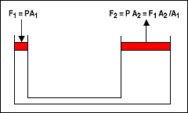
Pressure Definition
Static Pressure. Pressure, P, is defined as force, F, per unit area, A:
P = F/A

Slide 3
Pressure in open tank
A container filled with a liquid has a pressure (due to the weight of the liquid) at a point in the liquid of:
P = F/A
P = W/A
P = ρgV/A
P = ρghA/A
P = ρgh
P = pressure
F = force
A = Area
W = weight of the liquid
V = volume above the Area
g = gravitation
ρ = mass density
h = distance from the surface
h
A

Slide 4
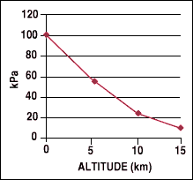
Static pressure of atmosphere
Gases differ from liquids in two respects: they are very compressible, and they completely fill any closed vessel in which they are placed.
The nonlinear air pressure variation with altitude shown in the figure is an example of the effect of the compressibility of gases.
The compressibility of gases is illustrated by nonlinear atmosphere pressure as a function of altitude

Slide 5
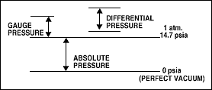
Types of Pressure measurements
Absolute pressure is measured relative to a perfect vacuum (psia)
Gauge pressure is measured relative to ambient pressure (psig)
Differential pressure is the difference in pressure between two points of measurement. (psid).
Note that the same sensor may be used for all three types; only the reference is different.

Slide 6
Dynamic Effects.
Static pressure is measured under steady-state or equilibrium conditions, but most real-life applications deal with dynamic or changing pressure.
For example, the measurement of blood pressure usually gives the two steady-state values of systolic and diastolic pressure.
There is much additional information in the shape of the blood pressure signal, however, which is the reason for the monitors used in critical-care situations.
To measure changing pressures, the frequency response of the sensor must be considered. As a rough approximation, the sensor frequency response should be 5-10 × the highest frequency component in the pressure signal.
Another issue is the remote measurement of pressure where a liquid coupling medium is used. Care must be taken to purge all air because its compressibility will corrupt the waveform.

Slide 7
Pressure in Moving Fluids
Bernoulli's theorem states that for horizontal flow the following relation holds:
PS = PO + PI
PS = stagnation (or total) pressure
PO = static pressure
PI = Impact pressure due to moving fluid
PI = ρV_{o} ²/2
Where V₀ = the velocity of the fluid
Hence we can measure the velocity if we know the pressure

Slide 8
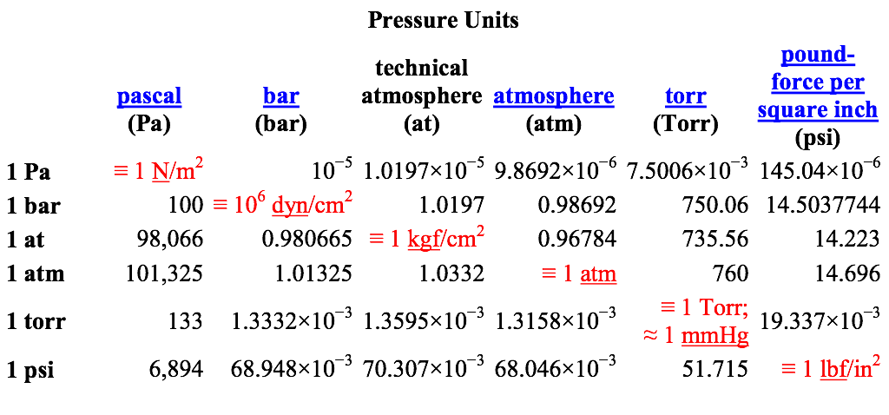

Slide 9
Pressure Sensing
Pressure
Pressure is sensed by mechanical elements such as plates, shells, and tubes that are designed and constructed to deflect when pressure is applied.
This is the basic mechanism converting pressure to physical movement.
Next, this movement must be transduced to obtain an electrical or other output.
Finally, signal conditioning may be needed, depending on the type of sensor and the application. Figure 8 illustrates the three functional blocks.
Sensing
Element
displacement
Transduction
element
electric
Signal
Conditioner
V or I output

Slide 10
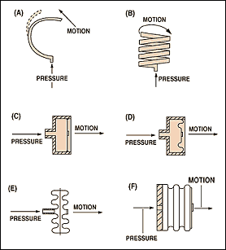
Sensing Elements
The main types of sensing elements are Bourdon tubes, diaphragms, capsules, and bellows
All except diaphragms provide a fairly large displacement that is useful in mechanical gauges and for electrical sensors that require a significant movement

Slide 11
Sensing Elements
Bourdon Tube : https://www.youtube.com/watch?v=-9IfpNAESlM

Slide 12
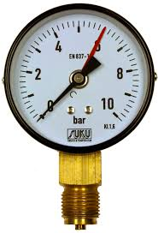
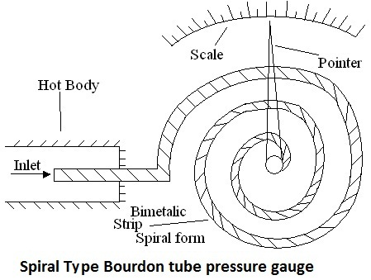
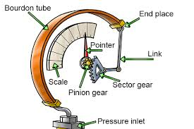
Sensing Elements
The Bourdon Pressure Gauge:
Named after the inventor
Completely Mechanical Gauge
Bourdon Tube mage of Copper.
May be ‘C’ type, spiral or helical shaped

Slide 13
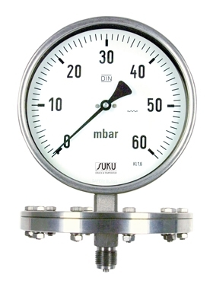
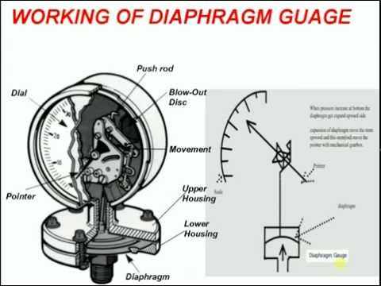
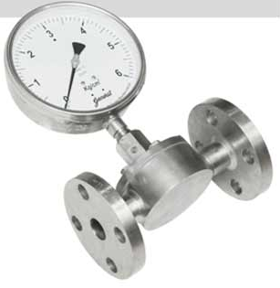
Sensing Elements

Slide 14
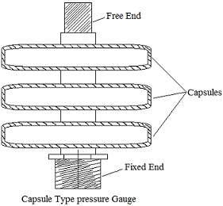
Sensing Elements
Construction:
A capsule type pressure gauge contains diaphragm elements.
A diaphragm element may consist of a single disc, while in other, two diaphragms are bonded together at their circumference by soldering or pressure welding to form a capsule.
Working:
The pressure to be measured is applied pressure.
The pressure gauge may consist one capsule or two or more capsules connected together with each capsule deflecting on the application of pressure.
The total deflection of the sum of the deflections of individual capsules.
The deflection is connected with high magnification linkage and to be the pointer to get the reading. It is used for measuring low pressure.

Slide 15
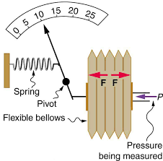
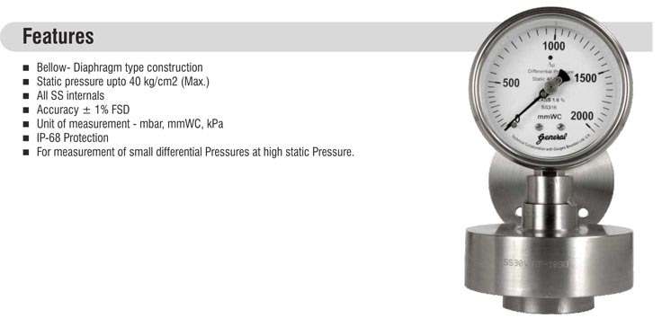
Sensing Elements

Slide 16
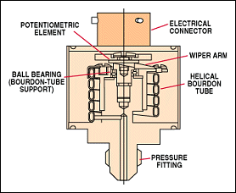
Potentiometric Pressure Sensors
Potentiometric pressure sensors use a Bourdon tube, capsule, or bellows to drive a wiper arm on a resistive element.
For reliable operation the wiper must bear on the element with some force, which leads to repeatability and hysteresis errors.
These devices are very low cost, however, and are used in low-performance applications such as dashboard oil pressure gauges

Slide 17
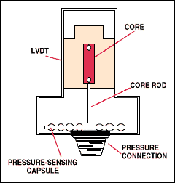
Inductive Pressure Sensors
Several configurations based on varying inductance or inductive coupling are used in pressure sensors.
They all require AC excitation of the coil(s) and, if a DC output is desired, subsequent demodulation and filtering. The LVDT types have a fairly low frequency response due to the necessity of driving the moving core of the differential transformer
The LVDT uses the moving core to vary the inductive coupling between the transformer primary and secondary.

Slide 18
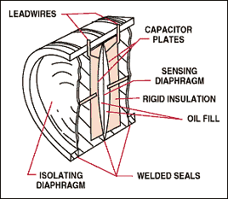
Capacitive Pressure Sensors
Capacitive pressure sensors typically use a thin diaphragm as one plate of a capacitor.
Applied pressure causes the diaphragm to deflect and the capacitance to change.
This change may or may not be linear and is typically on the order of several picofarads out of a total capacitance of 50-100 pF.
The change in capacitance may be used to control the frequency of an oscillator or to vary the coupling of an AC signal through a network.
The electronics for signal conditioning should be located close to the sensing element to prevent errors due to stray capacitance.

Slide 19
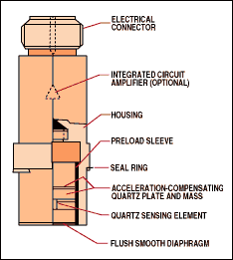
Piezoelectric Pressure Sensors.
Piezoelectric elements are bi-directional transducers capable of converting stress into an electric potential and vice versa.
One important factor to remember is that this is a dynamic effect, providing an output only when the input is changing.
This means that these sensors can be used only for varying pressures.
The piezoelectric element has a high-impedance output and care must be taken to avoid loading the output by the interface electronics. Some piezoelectric pressure sensors include an internal amplifier to provide an easy electrical interface.
Piezoelectric sensors convert stress into an electric potential and vice versa.
Sensors based on this technology are used to measure varying pressures.

Slide 20
Strain Gauge Pressure Sensors
Strain gauge sensors originally used a metal diaphragm with strain gauges bonded to it.
The signal due to deformation of the material is small, on the order of 0.1% of the base resistance
Semiconductor strain gauges are widely used, both bonded and integrated into a silicon diaphragm, because the response to applied stress is an order of magnitude larger than for a metallic strain gauge.

Slide 21
Strain Gauge Pressure Sensors
When the crystal lattice structure of silicon is deformed by applied stress, the resistance changes.
This is called the piezoresistive effect. Following are some of the types of strain gauges used in pressure sensors.
Deposited strain gauge. Metallic strain gauges can be formed on a diaphragm by means of thin film deposition.
This construction minimizes the effects of repeatability and hysteresis that bonded strain gauges exhibit.
These sensors exhibit the relatively low output of metallic strain gauges.

Slide 22
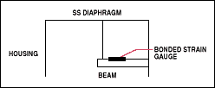
Strain Gauge Pressure Sensors
Bonded semiconductor strain gauge. A silicon bar may be bonded to a diaphragm to form a sensor with relatively high output.
Making the diaphragm from a chemically inert material allows this sensor to interface with a wide variety of media

Slide 23
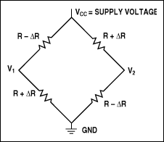
Piezoresistive Integrated Semiconductor
IC processing is used to form the piezoresistors on the surface of a silicon wafer
There are four piezoresistors within the diaphragm area on the sensor. Two are subjected to tangential stress and two to radial stress when the diaphragm is deflected.
They are connected in a four-element bridge configuration (see Figure 22) and provide the following output:
V_{OUT}/V_{CC} = ΔR / R

Slide 24
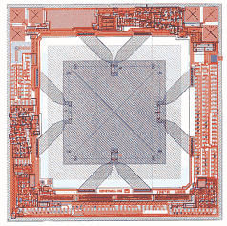
Piezoresistive Integrated Semiconductor
IC processing is used to form the piezoresistors
on the surface of a silicon wafer to fabricate
an integrated piezoresistive pressure sensor.

Slide 25
Pressure Switches
Pressure switches, combining a diaphragm or other pressure measuring means with a precision snap switch, can provide precise single-point pressure sensing.
Alternatively, simple electronic switches may be combined with electrical sensors to construct a pressure switch with an adjustable set point and hysteresis.

Slide 26
Electrical Interfacing
Care must be taken to avoid corrupting the signal by noise of 60/50 Hz AC pickup. If the signal must be run some distance to the interface circuitry, twisted and/or shielded wire should be considered. A decoupling capacitor located at the sensor and connected from the supply to ground will also filter noise, as will a capacitor from output to ground.
For long runs, a current output sensor should be considered. These devices have a 2-wire interface and modulate the supply current in response to applied pressure. Obviously, wire resistance has no effect and noise must change the loop current, not simply impress a voltage on the signal. The industry standard interface is:
PL = 4 mA PH = 20 mA
PL= low pressure range limit PH = high pressure range limit

Slide 27
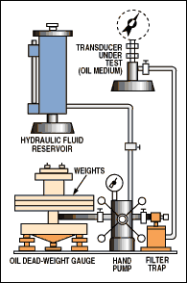
Calibration
Dead-Weight Tester. A dead-weight tester uses calibrated weights that exert force on a piston which then acts on a fluid to produce a test pressure.
For high pressures (>500 psi), oil is typically used
For lower pressures, pneumatic air bearing testers are available and are much more convenient as well as less messy to use.

Slide 28
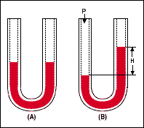
Manometer
A mercury manometer is a simple pressure standard and may be used for gauge, differential, and absolute measurements with a suitable reference.
It is useful mainly for lower pressure work because the height

Slide 29
Selection Considerations
Selection of a pressure sensor involves consideration of the medium for compatibility with the materials used in the sensor, the type (gauge, absolute, differential) of measurement, the range, the type of electrical output, and the accuracy required.
Manufacturer's specifications usually apply to a particular temperature range. If the range of operation in a given application is smaller, for example, the errors should ratio down.
Total error can be computed by adding the individual errors (worst-case) or by computing the geometric sum or root sum of the squares (RSS). The latter is more realistic since it treats them as independent errors that typically vary randomly.

Slide 30

Selection Considerations
Following is a comparison of the two methods.
Given the following error terms:
Linearity = 1% F.S.
Null calibration = 1% F.S.
Sensitivity calibration = 1% F.S. Temperature errors are sometimes given as coefficients per ºC referenced to 25ºC. Simply multiply the coefficient by the temperature range of the application to obtain the total error.
Temperature error = 0.5% F.S.
Repeatability and hysteresis = 0.1% F.S.

Slide 31
Selection Considerations
Worst case error is equal to the sum of all the maximum errors:
Worst case error = 1 + 1 + 1 + 0.5 + 0.1 = 3.6%

Slide 32
Industrial Applications
Fluid level in a tank: A gauge pressure sensor located to measure the pressure at the bottom of a tank can be used for a remote indication of fluid level using the relation:
h = P/ρg
Fluid flow: An orifice plate placed in a pipe section creates a pressure drop. This approach is widely used to measure flow because the pressure drop may be kept small in comparison to some other types of flowmeters and because it is impervious to clogging, which may otherwise be a problem when measuring flow of a viscous medium or one containing particulate matter. The relation is:

